Slide 1
Bins
Bins

Slide 2
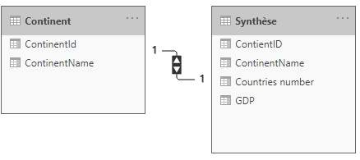
Bins
Note: This Lab uses the gdp.xslx file located in the resources\Drillthrough and Filter folder
Navigate to the location of the gdp.xslx file and load both tables continent and gdp 2018 at the query editor level
Import the Summary table at the table list level
Check that the relationship is well established between Contains and Synthesis

Slide 3
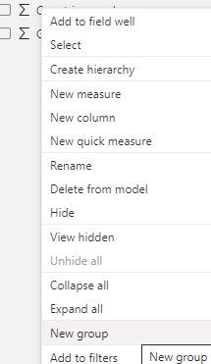
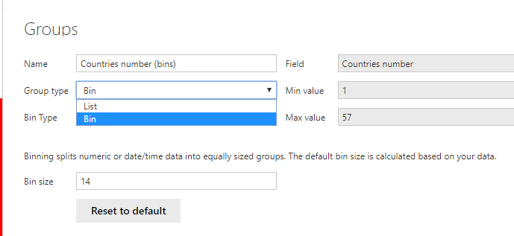
Bins
Right click on the fields area on Countries number and apply the New group function
Notice that the interface is a bit similar

Slide 4
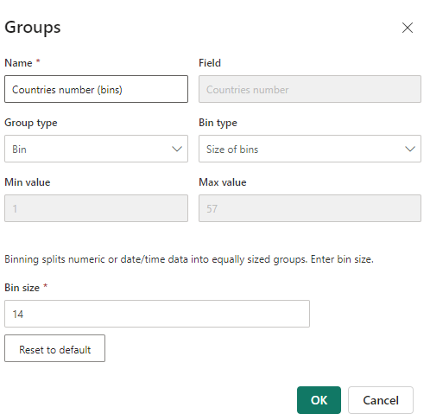
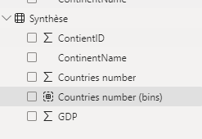
Bins
Note that now there are two options at Bin Type level namely Bin and List
Choose Bin and notice the presence of a new field in the Summary table : Countries number (bins)
Bin size parameter from 14 to 10
1
2

Slide 5
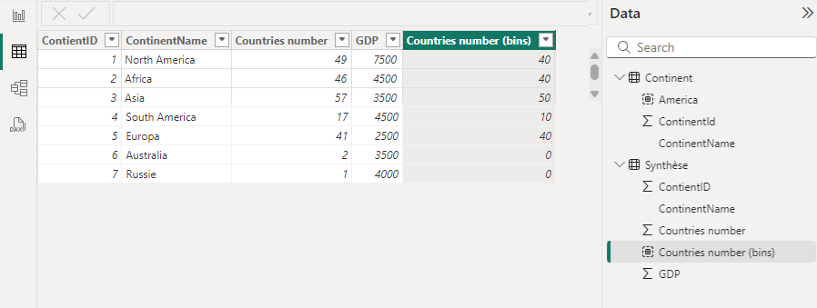
Bins
Note that at the data part level the new column represents a kind of classification of the countries according to the number of countries according to intervals
41,49 and 46 →40
57 →50
17 →10
1 and 2 →0

Slide 6
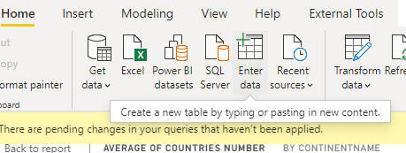
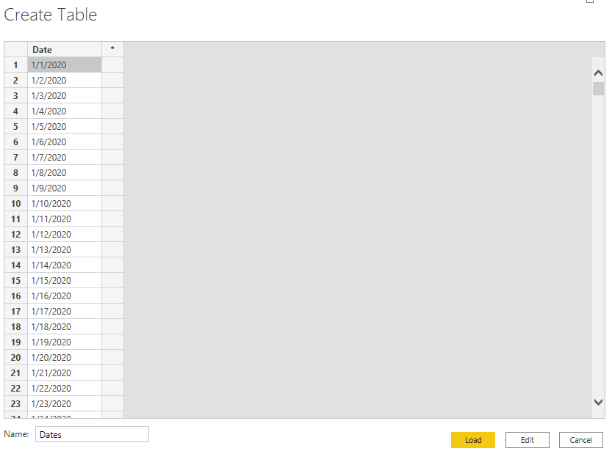
Bins
Switch to Excel and generate a set of dates then enter these dates directly as a new table into Power BI using the Enter Data import option

Slide 7
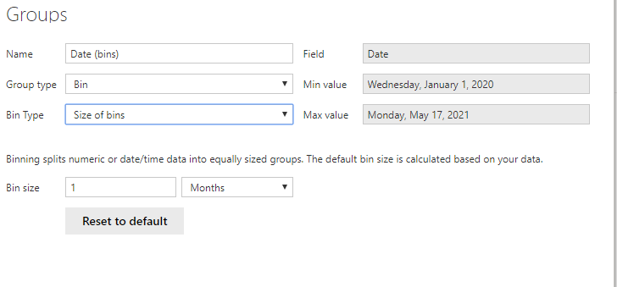
Bins
Try creating a group from this date list and notice the change in the group creation interface

Slide 8
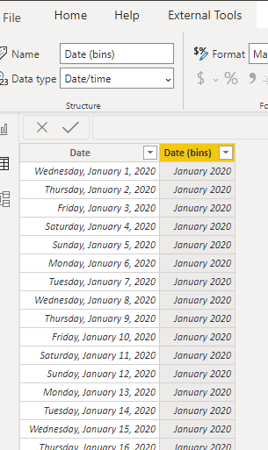
Bins
Check the table structure at the data level

Slide 9
Thank you
Thank you

